Slide 1

Lecture 5: Recurrent Neural Networks and sequential problems
McGill Artificial Intelligence Society

Slide 2
Announcements
Assignment 4
Due next week
Deliverable 3
Due next week

Slide 3
Today’s Lesson Plan
Recap of feed-forward neural networks
What kind of problems can vanilla NNs not solve?
Recurrent Neural Networks
Vanishing gradient problem
Long Short Term Memory
Shortcomings of RNNs (and NNs in general!)
Demo

Slide 4
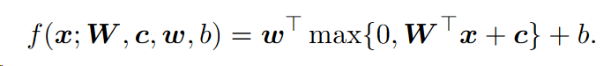
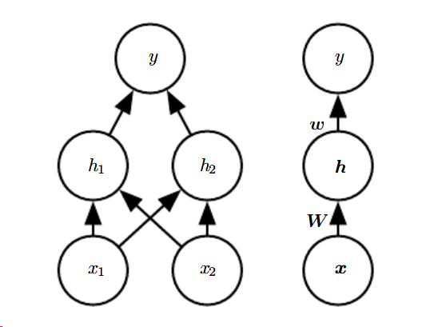
Recap: Feed-forward Neural Networks
Output of a single hidden layer neural network with rectified linear activation.
RHS is condensed version of LHS.
Why is it called feed-forward?
Taken from http://www.deeplearningbook.org/contents/mlp.html
Notes:
As a short recap for vanilla NNs, recall the structure of neural networks:
Input x
first weight matrix is W (plus the bias term of the first weights c)
relu applied (max{...})
second layer of weights w (plus bias of second layer, b)
final output y
Universal function approximator
(Ask the class) What problems can vanilla feed-forward neural networks NOT solve?

Slide 5
Shortcomings of non-sequential neural networks
No notion of “time” in a vanilla neural network
fixed length input/output
Notes:
Two gaps in the domain of vanilla neural networks
First, the order in which we input our features doesn’t particularly matter. Why doesn’t it matter? (give example of MNIST - you could reverse or changed ordering of the flattened input for every input picture, and as long as the order of each pixel stays the same for every input your neural network would still work
Second, your inputs and outputs are fixed length. What if I wanted to do language translation? input size != output size, how would I go about training something like this?

Slide 6
Solution: Recurrency and sharing parameters
In vanilla neural network, each input has its own parameter (elements of W).
“I went to Nepal in 2009” and “In 2009,I went to Nepal.”
Every input (word) has its own weight
Recurrent neural network shares weights across multiple time steps
Refer to inputs of a sequential problem as x_t, with t being the time-step index from 1 … T.
:
Notes:
Each feature has its own parameters. How would we parse a sentence like this?
RNNs share weights across each time step
Problems we deal with have the form x^(t). While t is called the time step index, it could refer to any “step” index for any sequential input.

Slide 7
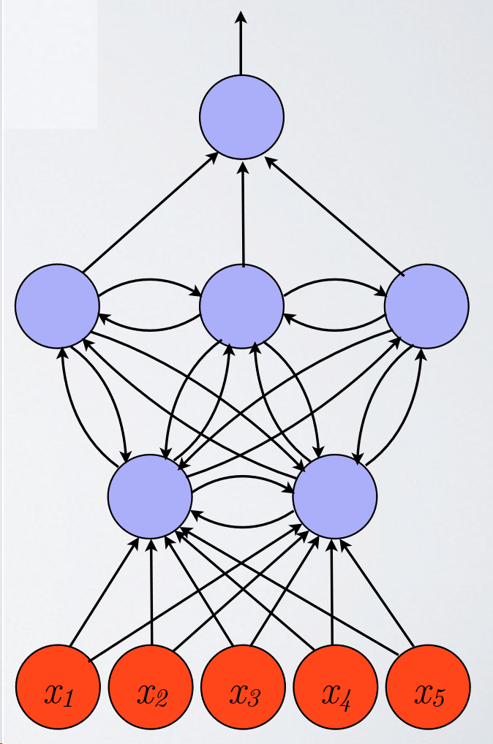
Recurrency and Cycles
What does recurrency and cycles in our computation graph allow us to do?
Keep internal state throughout time steps
Allow us to work with time-series data
Capture oscillatory patterns
Ignore parts of input sequence

Slide 8
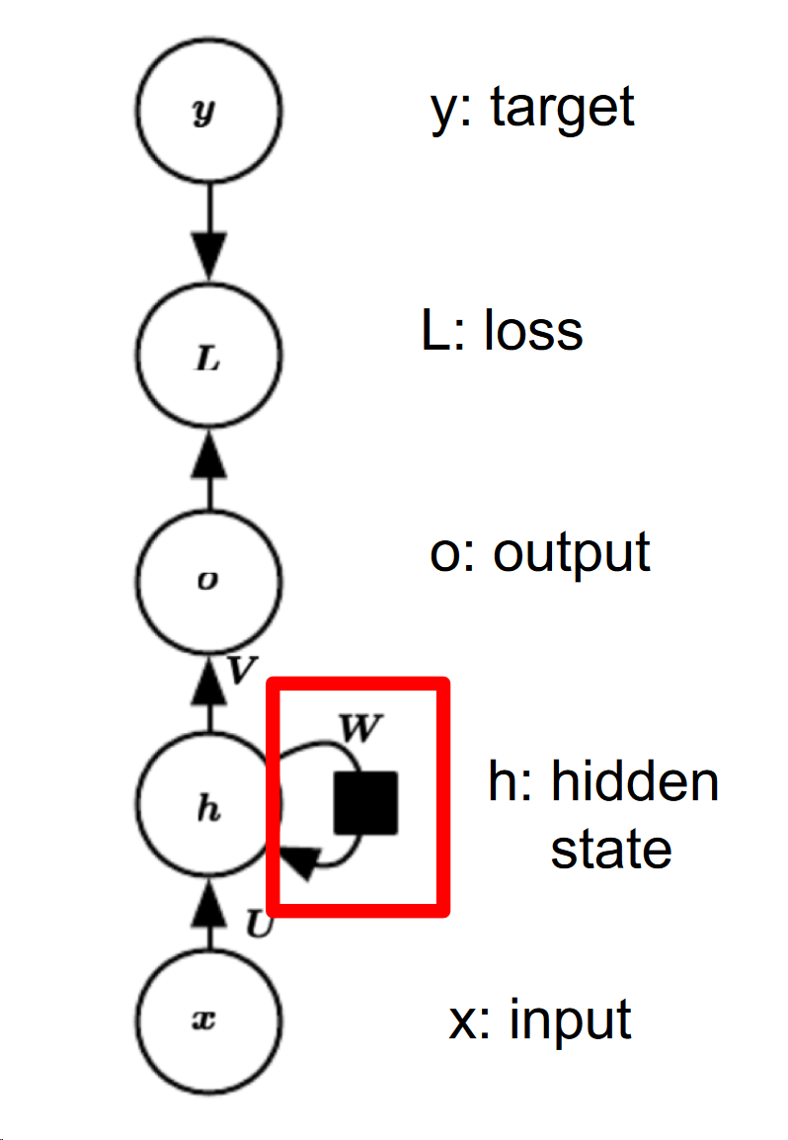
How do we incorporate a sequential flow of information?
What kind of cycles do we use?
Time delay cycles - information from this state is sent to next state
There is a “remembered” state that is passed forward in the sequence. We call this the hidden state of an RNN (h_t).
We can use h_t as input into some downstream model (ie. for machine translation, distribution over target dictionary)
Slide adapted from Herke Van Hoof’s - COMP 551 Lecture 13 on Dimensionality Reduction
Notes:
We have time delay cycles in our computational graph. When we mean cycle we mean a cycle with a time delay - pass the message (which is hidden state) forward.
Now we use this hidden state (message from before) as another input to the next time step so that we CONDITION on previous states/inputs.

Slide 9
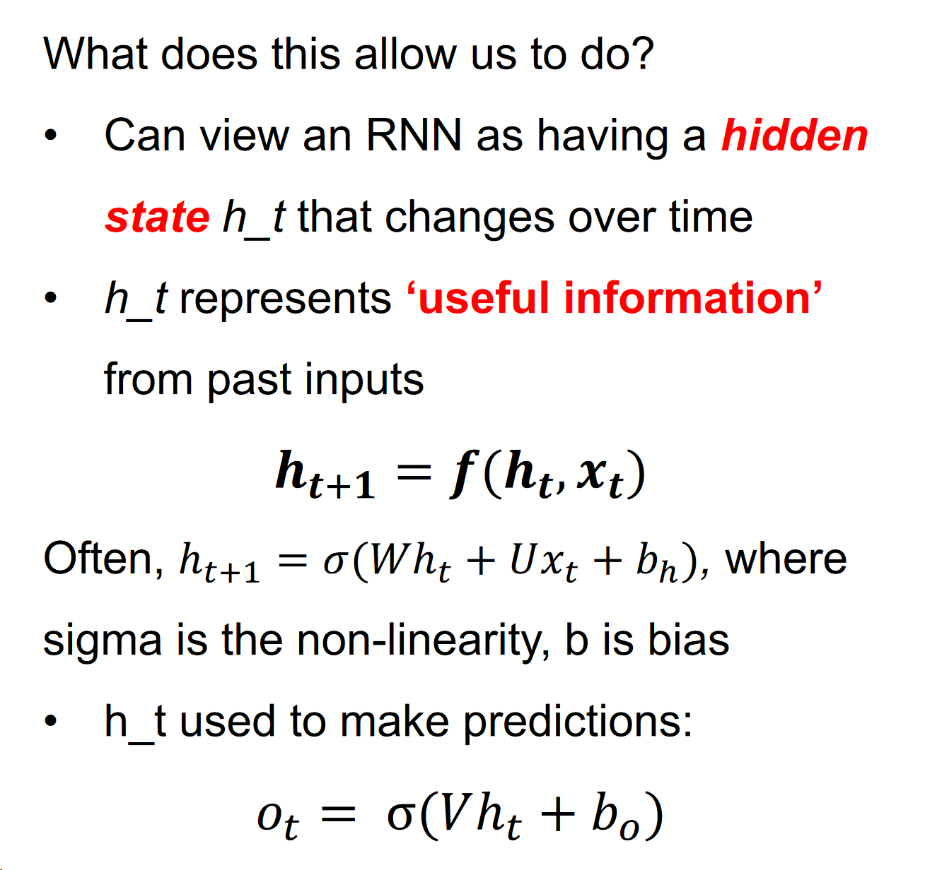
RNNs continued.
Taken from Ryan Lowe/Joelle Pineau’s COMP 551 slides
Notes:
What does passing state forward through time allow us to do?
Structure of an RNN - how do we normally compute predictions etc with an RNN? - EXPLAIN THIS

Slide 10
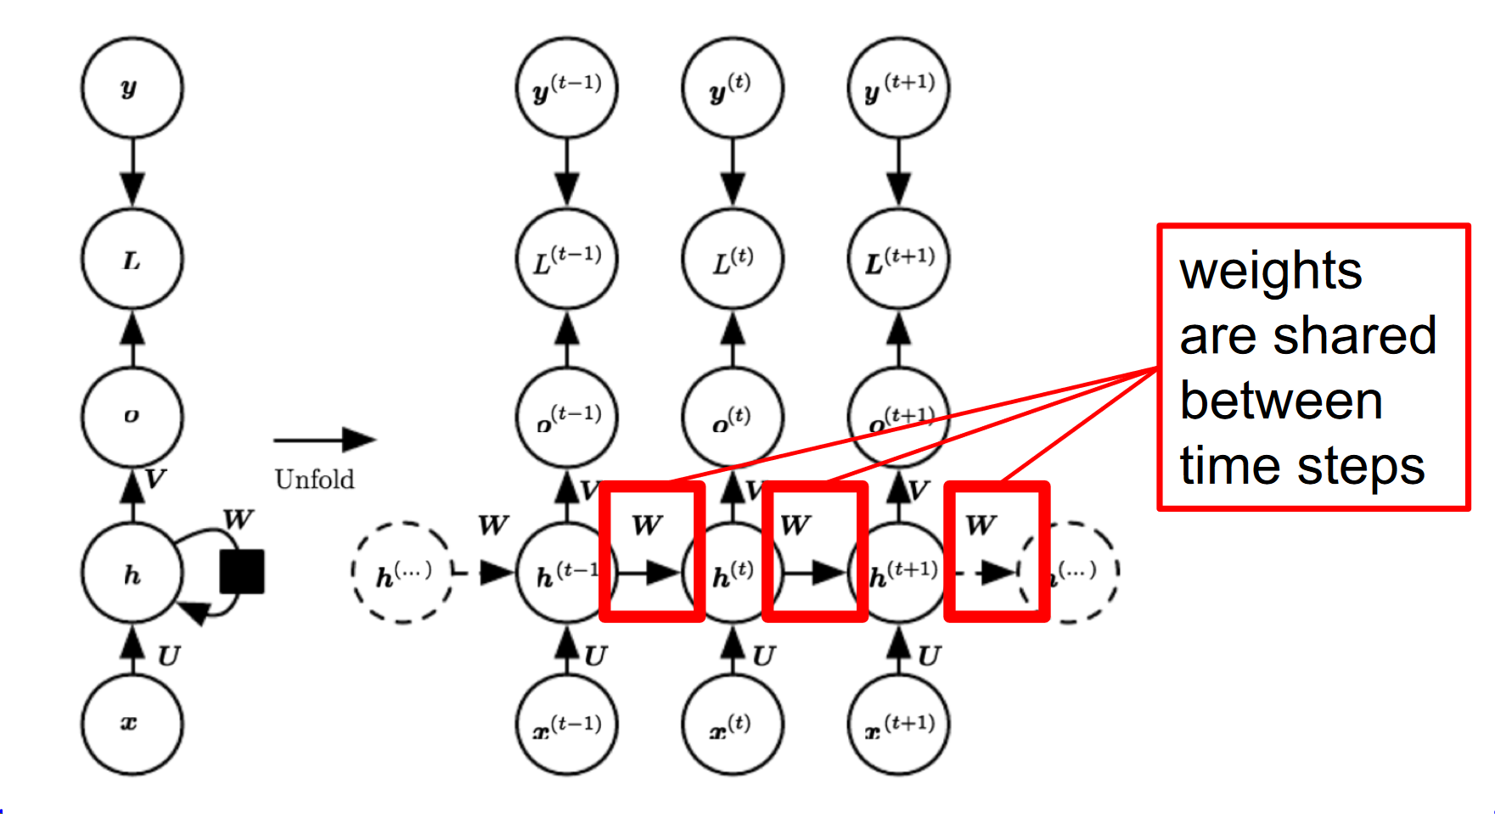
Unfolding the computational graph
This is actually what’s happening during an RNN computation - we continually predict the next hidden state, and use this for predictions. But how do we train this model?
Notes:
More clear view of what the computational graph looks like.
NOTICE the weights w being shared between each hidden state! THEY ARE THE SAME WEIGHT
How do we train such a network?

Slide 11
How do we train RNNs?
Same as feed-forward networks, we use back-propagation on our “unrolled” computation graph.
Use chain rule to calculate partial derivatives
SAME as feed-forward neural networks! We call this Backpropagation through time (BPTT).
Notes:
Same as FFN! Compute partial derivatives as you would before, except over TIME
we call this backpropagation through time. d/dx_t = ….. indexed over t! each term relies on the previous time step.
Can anyone see an issue with this setup?........ Let’s take a look at the potential problems of this recurrency

Slide 12
Problem with long-term dependencies
Example: Language modelling.
“I grew up in France, [long sentence here], I speak fluent ____” -> Model trying to predict next word.
In practice - very hard for RNNs to learn long-term dependencies.
Why is this?
Notes:
Let’s take a look at an example (DESCRIBE)
In practice, it’s actually very hard for an RNN to learn long-term dependencies (like France and French.)
Anyone have any idea why it might have this issue?

Slide 13
Problem with long-term dependencies cont.
Remember: transition between hidden states uses the same weight w for all time steps.
Can cause gradients to either explode or vanish - imagine multiplying a scalar by itself n number of times. What happens? Similar with matrices!
If you’re interested in eigendecomposition view on this, check out the 551 slides here
If you’re interested in a mathematical view of this check out this from U of T
Notes:
Remember, we use the same weight matrix w between each layer. Repeated multiplication of w with hidden states can cause gradient to explode/vanish.
Imagine repeatedly multiplying some initial value by w repeatedly. if w > 1 then value will explode. if w < 1 then value will vanish.

Slide 14
Fixing vanishing/exploding gradients
Clip gradients:
if |gradient| > max_val :
gradient = value * sign(gradient)
More complex RNN architecture to include non-multiplicative interactions.
Note: next few slides (15 - 22) all taken from Ryan Lowe/Herke Van Hoof/Joelle Pineau’s 551 slides.
Notes:
We can somewhat alleviate this issue in two ways:
Gradient clipping - if gradients go above a certain value, just use that max value instead
More complex RNN architecture

Slide 15
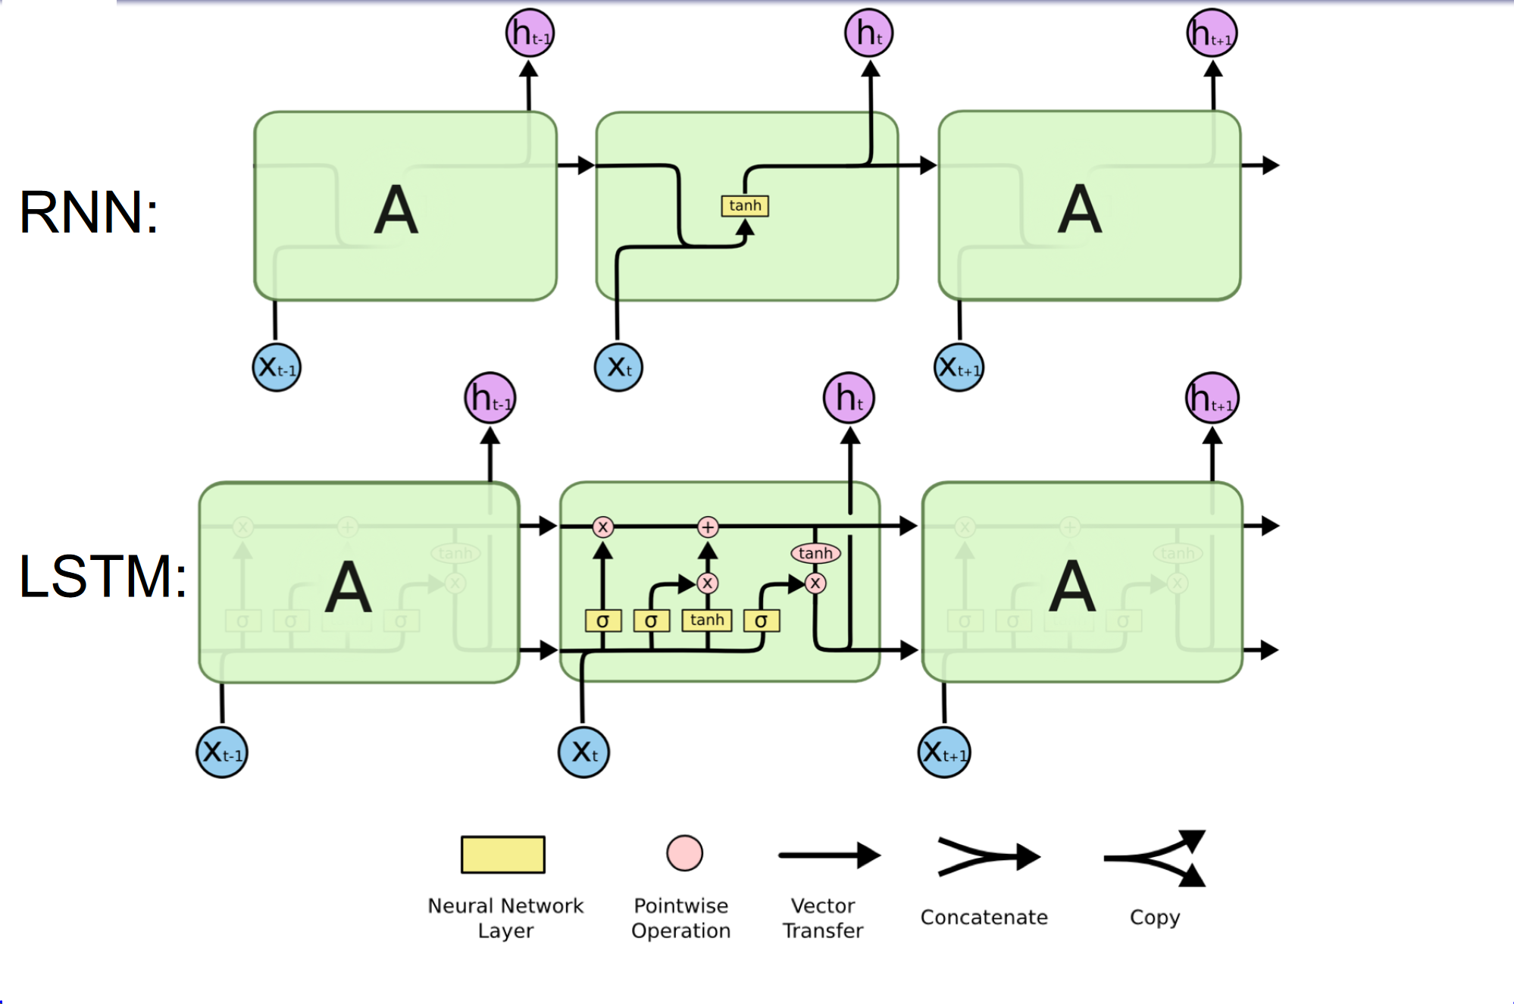
Long Short-Term Memory (LSTM)
Notes:
THis is gonna be so long and hard to explain ugh
Check for time - if there’s enough time pull up the slides

Slide 16
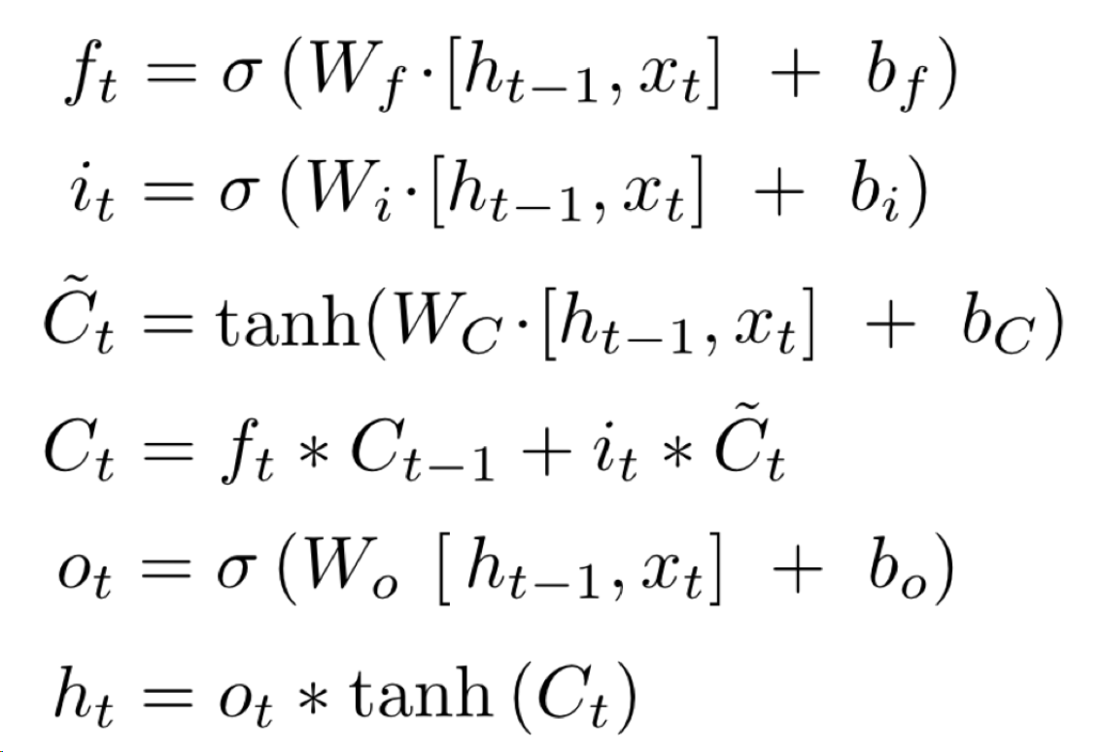
LSTM components
Governed by this set of equations below
Has two type of “states”, cell state and the previous hidden state we mentioned
Slides 16-21 Taken from Herke Van Hoof’s COMP551 Slides Lecture 13 - Dimensionality Reduction

Slide 17
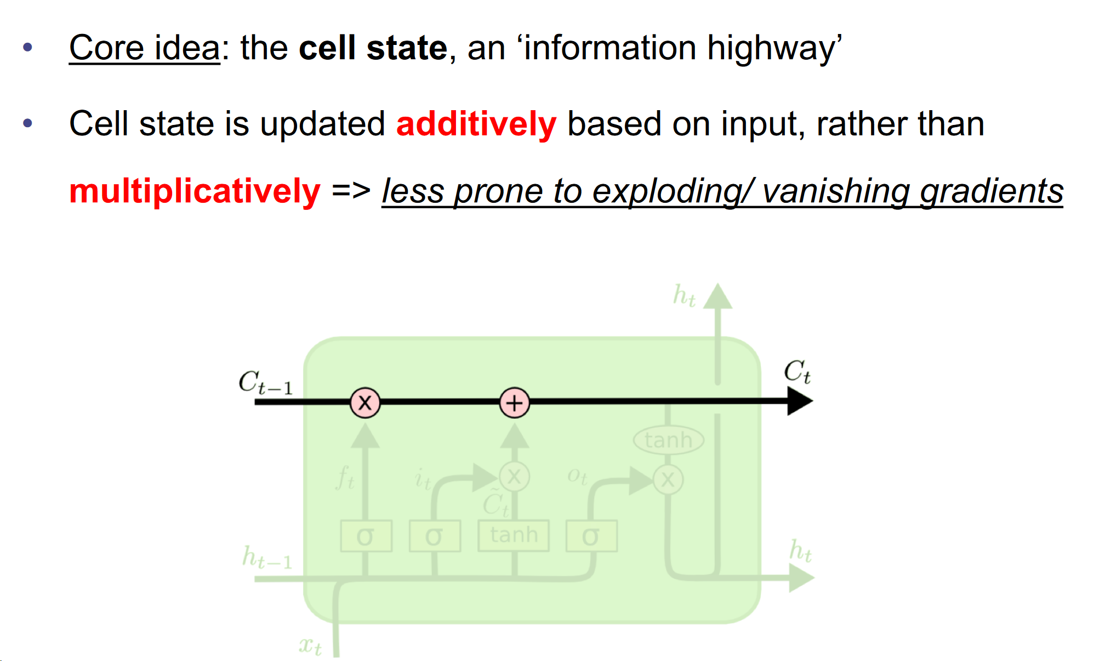
Long Short-Term Memory (LSTM)

Slide 18
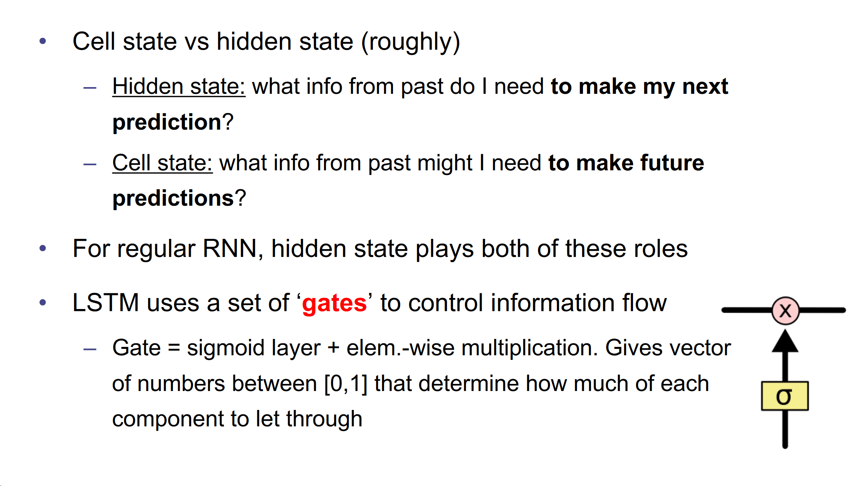
Long Short-Term Memory (LSTM)

Slide 19
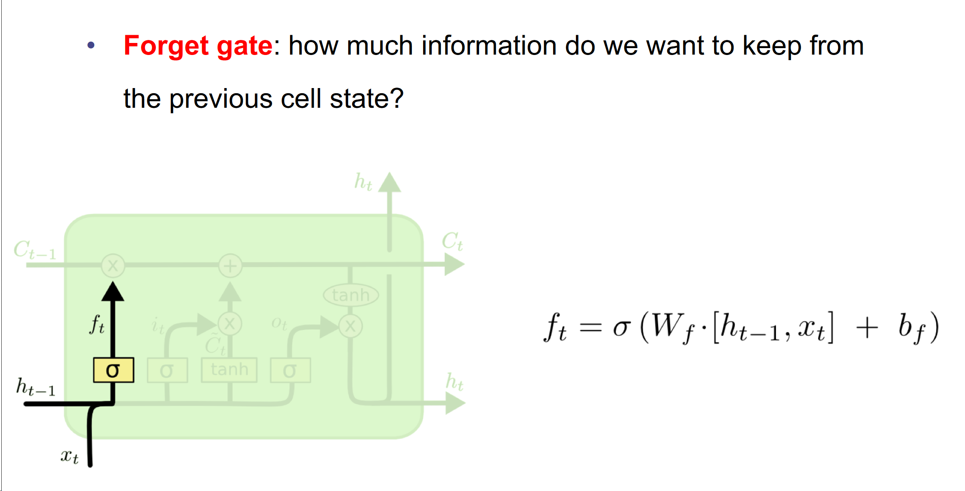
Long Short-Term Memory (LSTM)

Slide 20
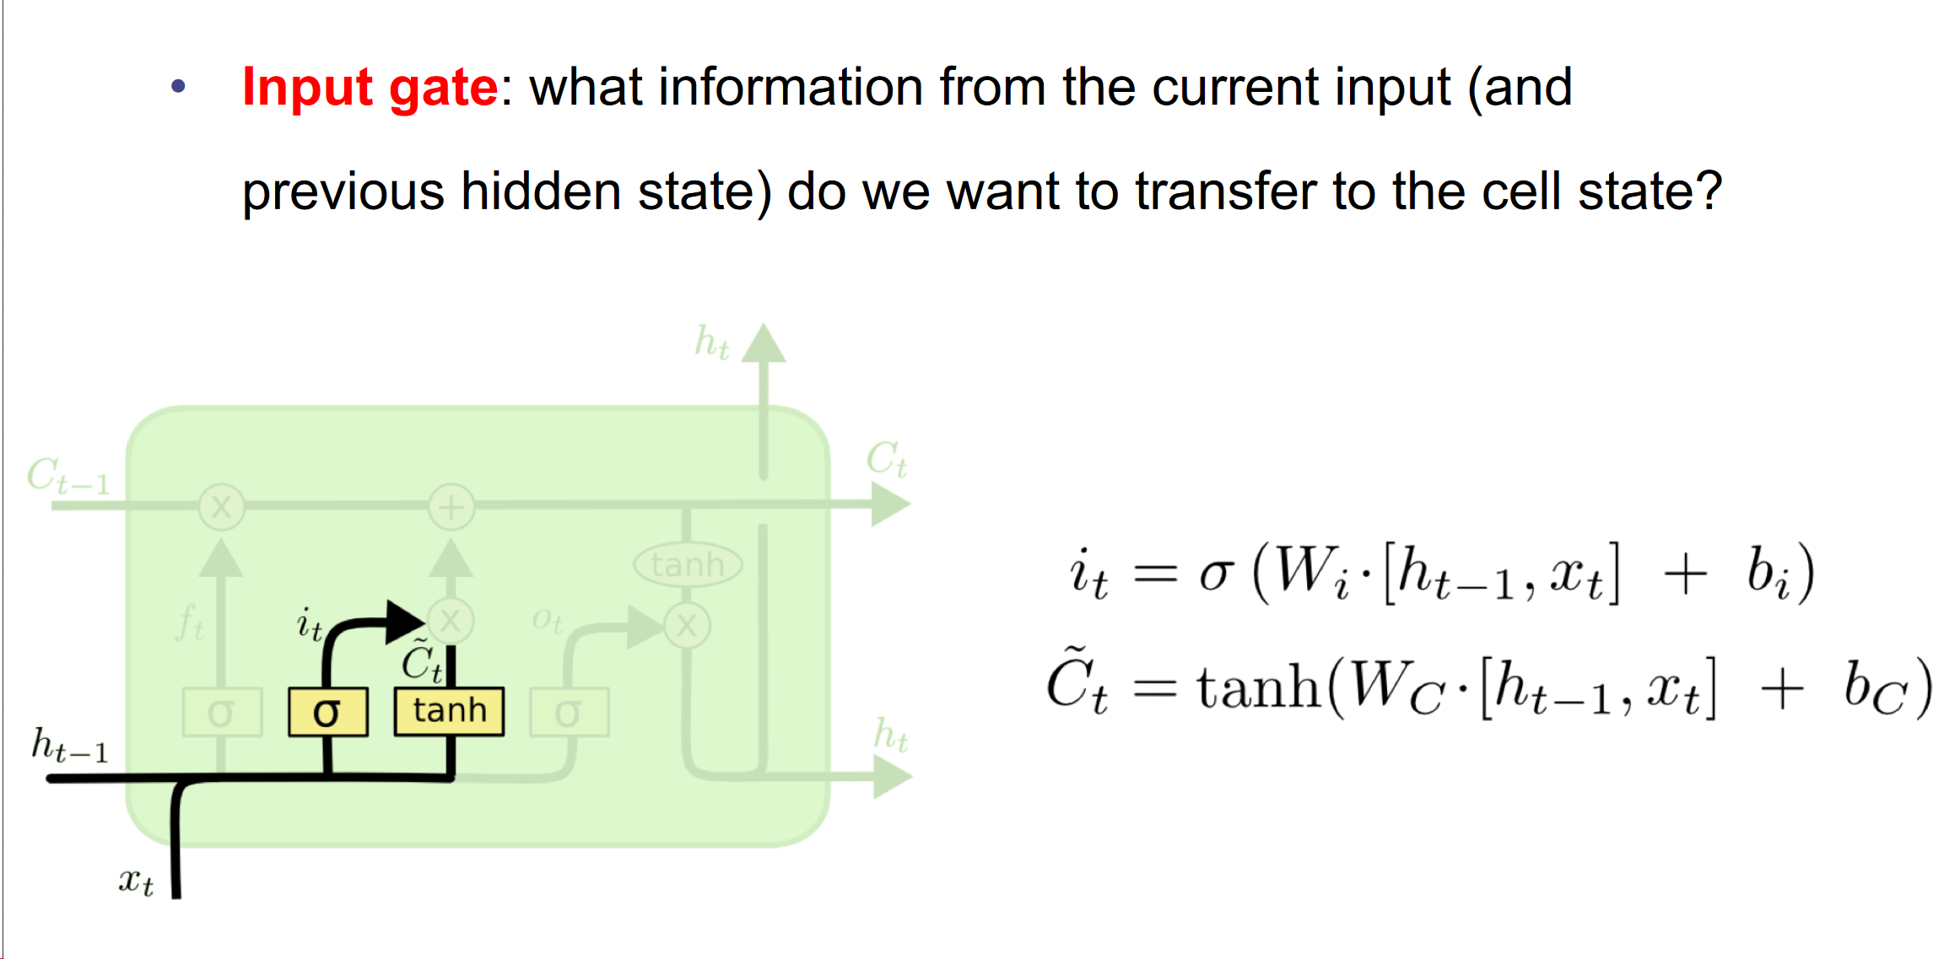
Long Short-Term Memory (LSTM)

Slide 21
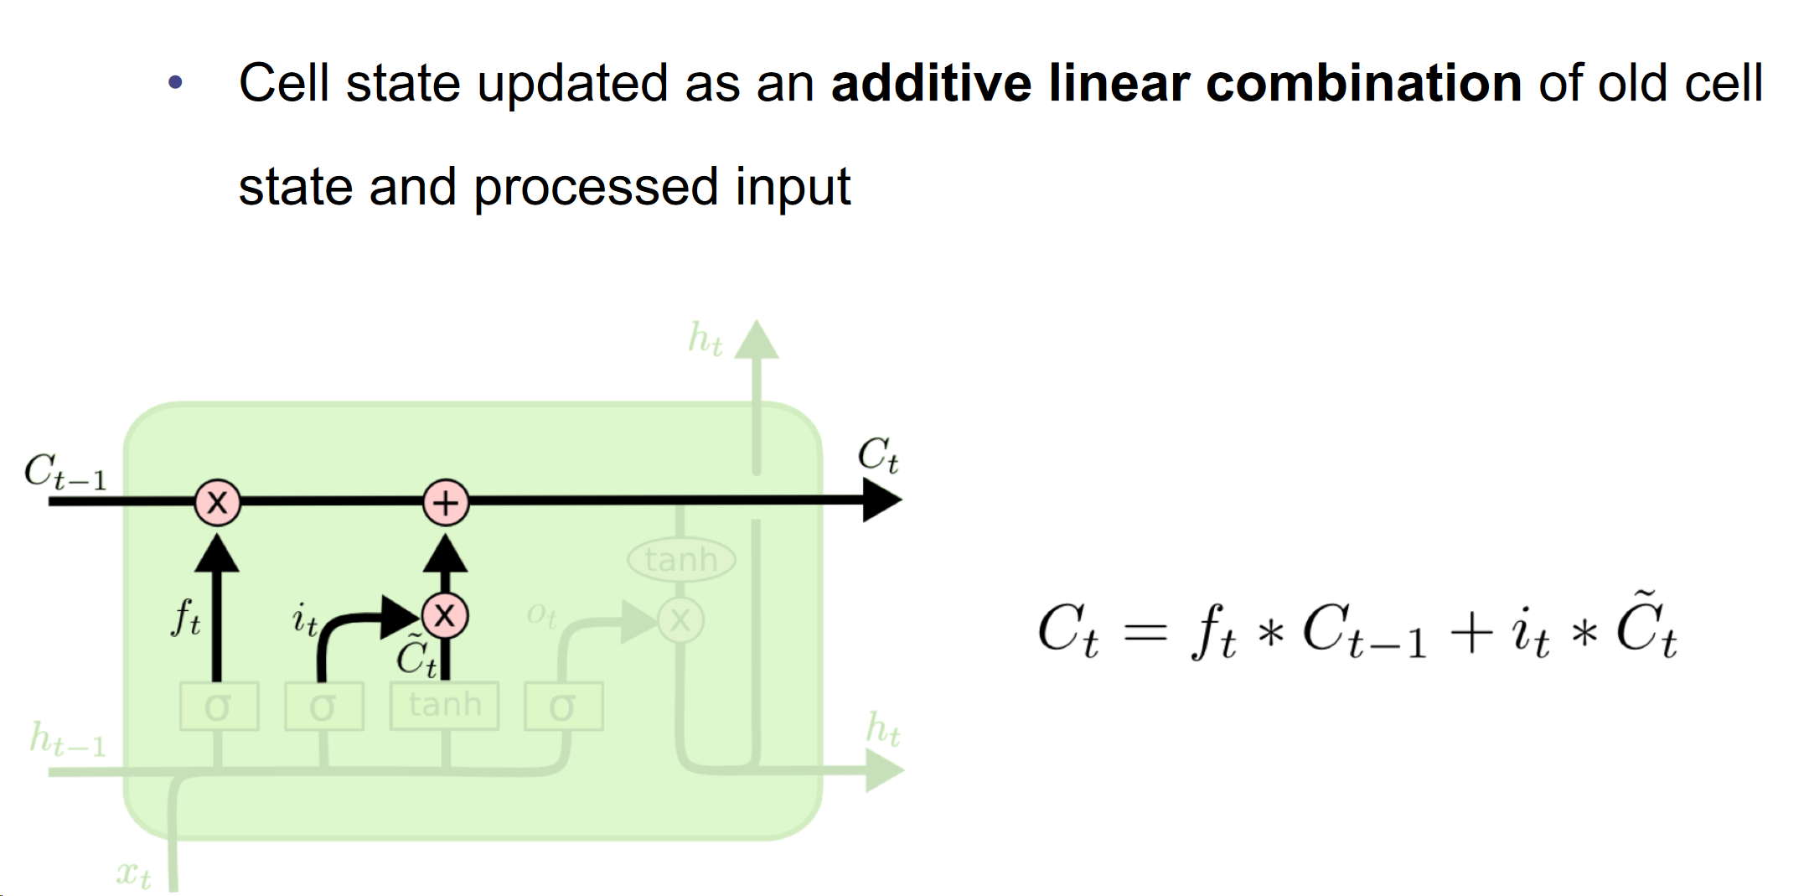
Long Short-Term Memory (LSTM)

Slide 22
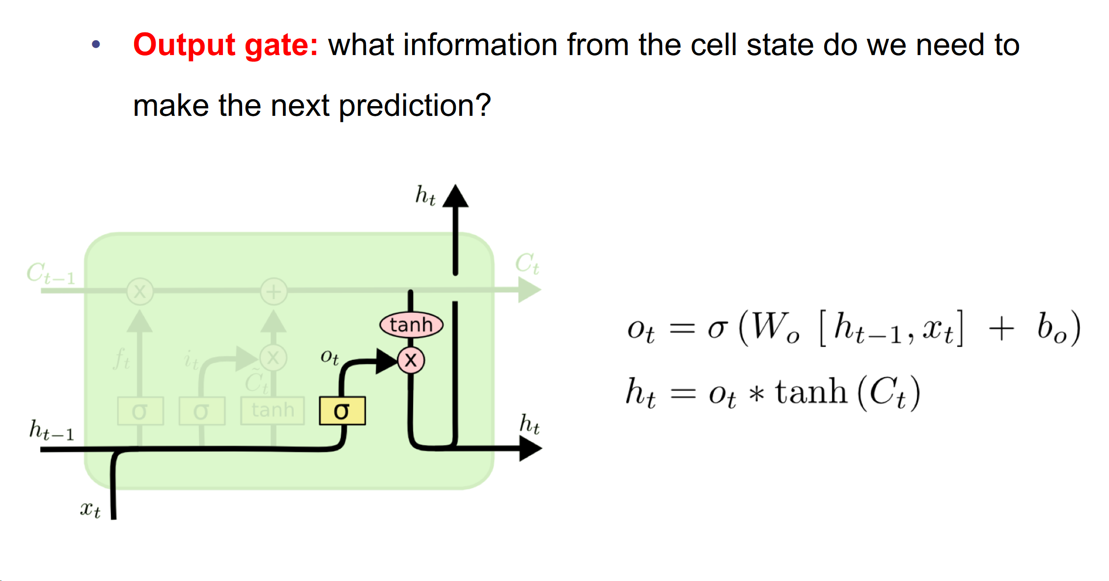
Long Short-Term Memory (LSTM)

Slide 23
LSTM components cont.
Still interested? For a more in-depth explanation of RNNs and LSTMs check out:
https://colah.github.io/posts/2015-08-Understanding-LSTMs/
What are some things we can do with RNNs?

Slide 24
5 minute break

Slide 25
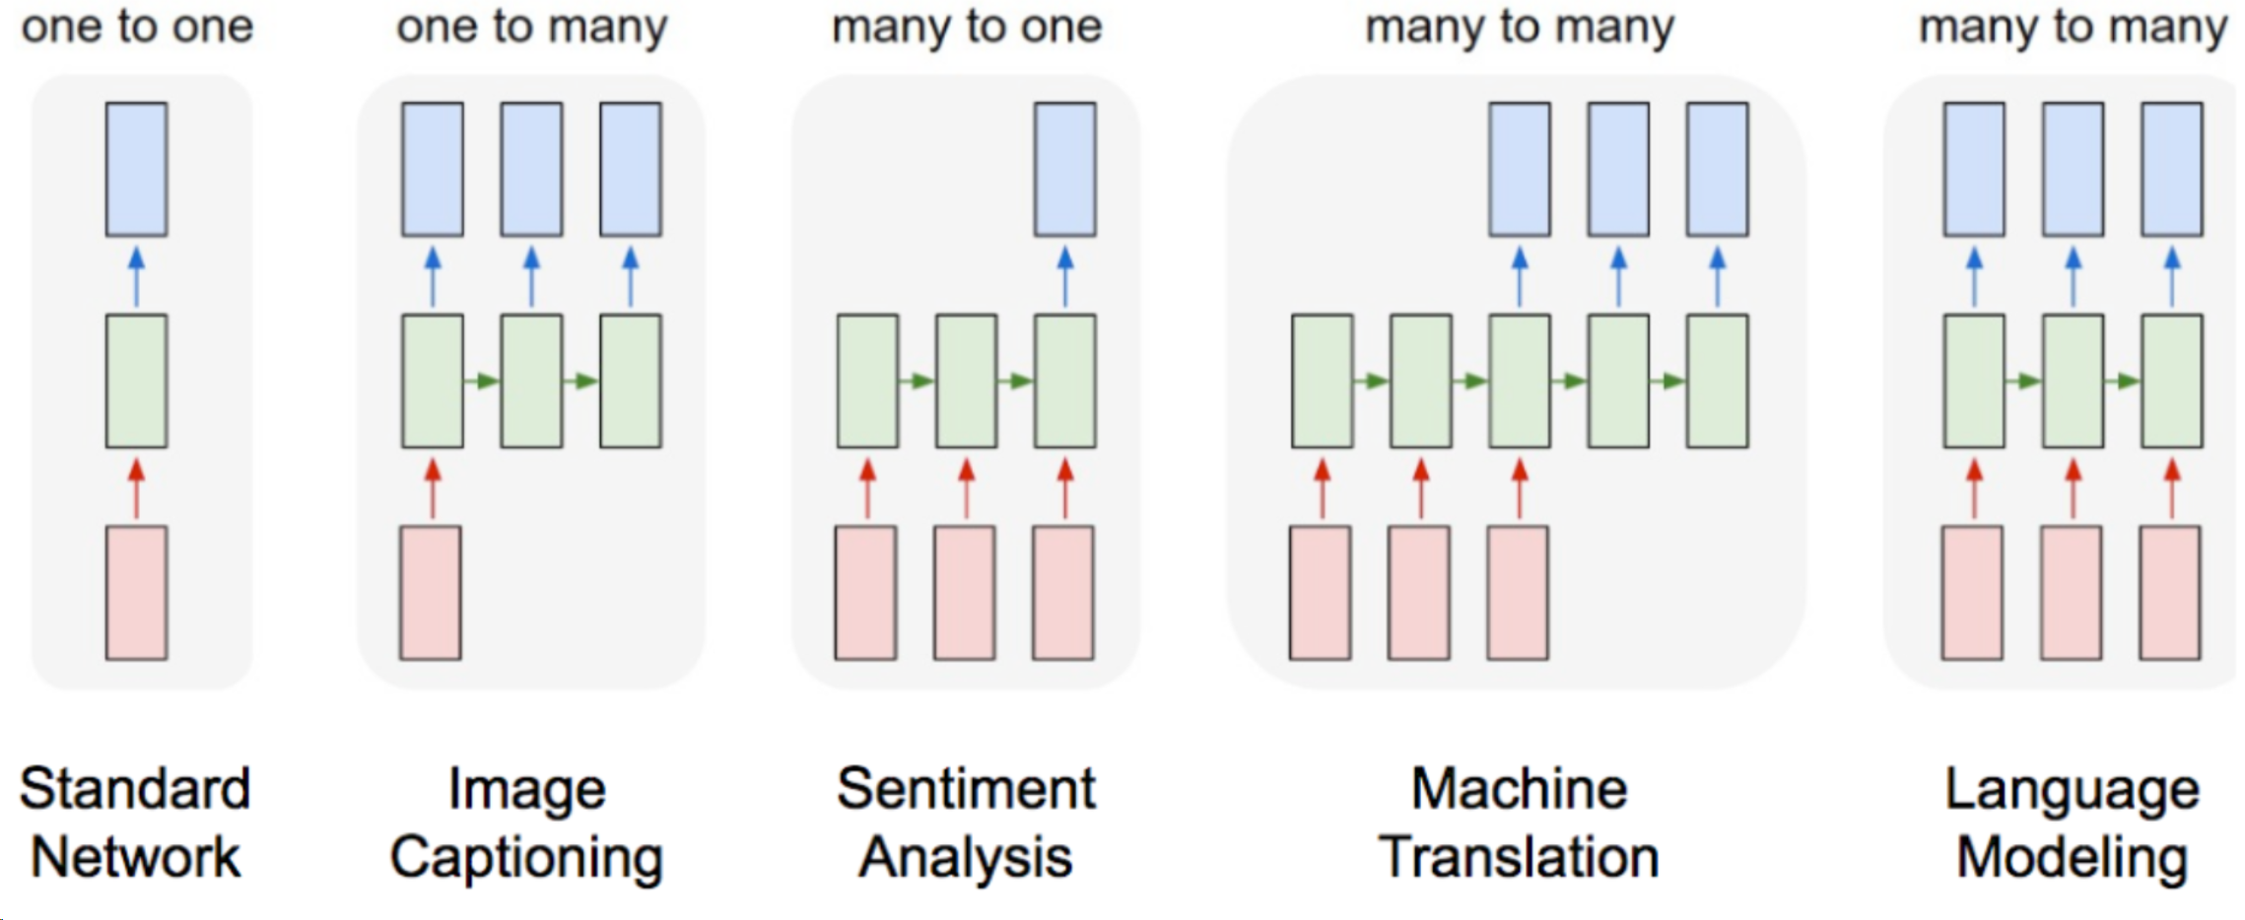
How do we apply this to a downstream task?
Sequential nature of RNNs allow us to apply it to many tasks, for example...
Notes:
So what can we do with these recurrent units?
Many tasks that have sequential input/output!
We’ll be focusing on the classic example of machine translation

Slide 26
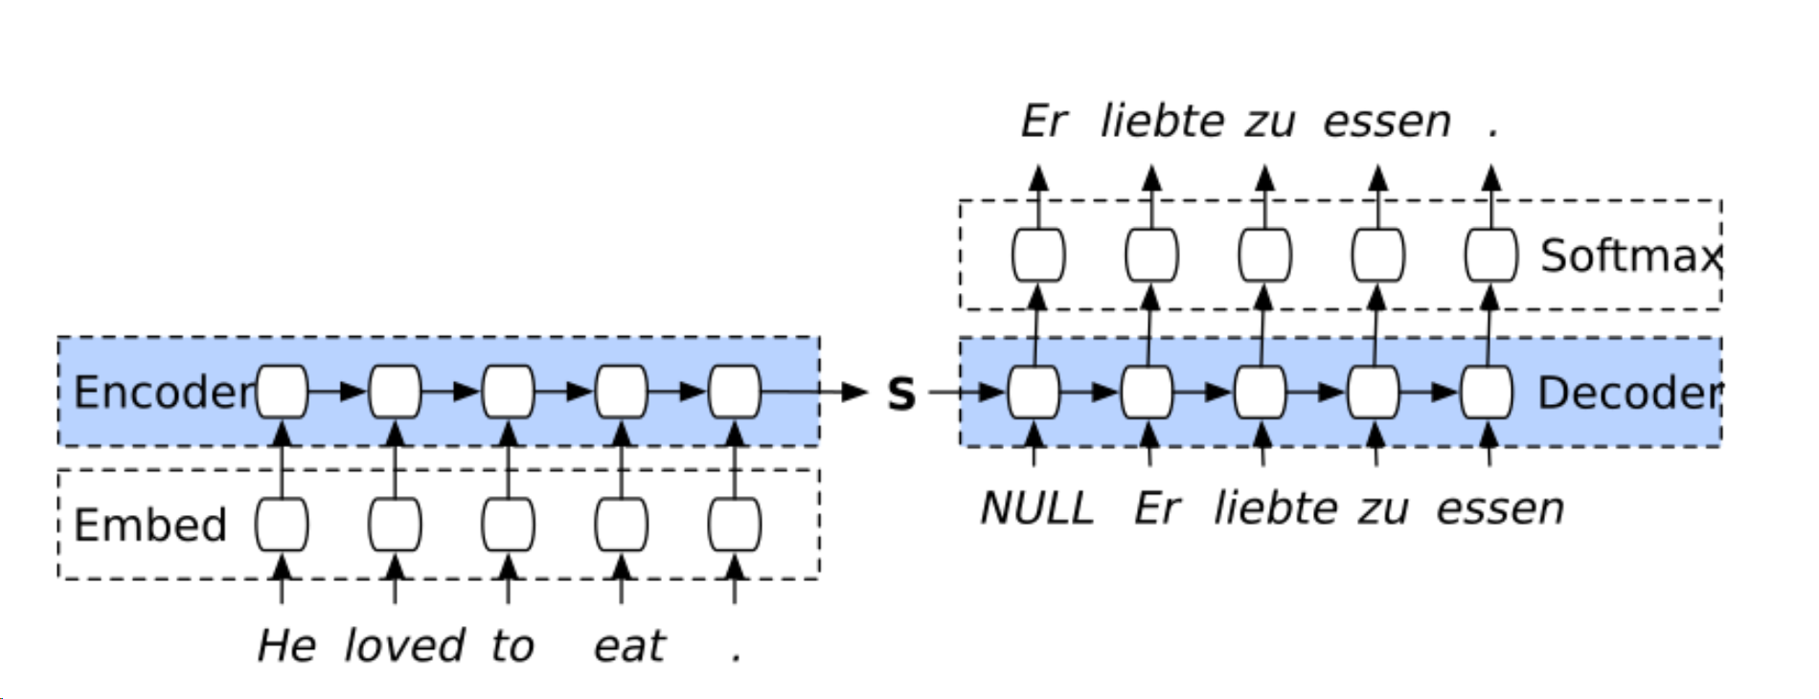
Sequence to sequence models
One of the most popular approaches towards sequential data are Sequence to Sequence (Sutskever et al, 2014.) models.
Follows an encoder-decoder architecture.
Notes:
Very popular approach to machine translation (and many other tasks!) are sequence to sequence models.
They follow an encoder to decoder architecture. You can think of these as something that
encodes the input into some (or multiple) states, and passes this encoding on to….
decoder takes in this state and decides what to output at every state.
Now let’s first talk about the encoder!

Slide 27
Encoders with RNNs
Representation learning for sequences
Builds a representation of input sequence with the hidden state.
First embeds each input from a word index into something in R^n, where n is embedding size.
Then passes this embedding to the RNN, RNN generates a hidden state
Sequentially takes in input and has a final “representation” of entire sentence in final hidden state (h_T).
How could we encode variable length sentences?
h_0
h_1
h_2
h_3
h_4 = S

Slide 28
A quick aside on embeddings
Vector representations of a certain word.
Used for capturing context. Why do we need them?
ie. “have a good day” vs “have a great day” - barely any difference in meaning.
We can map each word in the combined vocab into the following dictionary:
0 = have, 1 = a, 2 = good, 3 = great, 4 = day
One-hot encodings of each will tell us that (in terms of euclidean distance) have and day are as dissimilar as great and good - which is not true!
We need a way of capturing similarity in vector space!

Slide 29
Word embeddings cont.
We do this with multiple methods
frequency based methods (how often does a word show up in this set of documents? or similar words appear close to each other)
prediction based methods (solve the prediction problem of given a context, predict a word / given a word, predict a context, then use the weights)
Allows us to do cool things in embedding space like
embed(king) - embed(man) + embed(woman) = embed(Queen)
If you’re interested in learning more about embeddings, check this article out
Notes:
Before getting into the math behind it, let’s take a quick look at PCA does visually! (Slide)

Slide 30
Back to seq-to-seq
Now that we have representations of each word, we feed those in to an RNN to find a combined representation of the entire sentence.
How do we use this to “decode” the input sentence into another language?

Slide 31
Decoders
We use this representation of our sentence to output a probability distribution over our target vocab
We pick the max of this distribution as the output
And feed this output (or maybe not???) as the input to the next step
How do we generate variable length sequences?

Slide 32
RNN Demo
Notes:
So now, we’ll be taking a look at an application of PCA, called eigenfaces.

Slide 33
Extensions
Encoding entire translated sequence from one vector - super impressive!!!
This doesn’t really work in practice too well…
while LSTMs help with the vanishing gradients problem, it’s still very hard to remember context from so long ago
It would be nice if at every step we could see all the previous encoded words and do something with those hidden states….

Slide 34
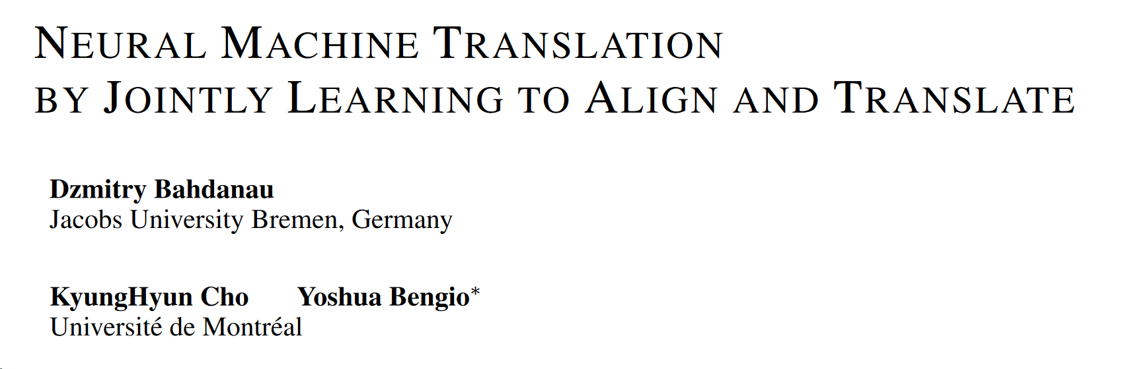
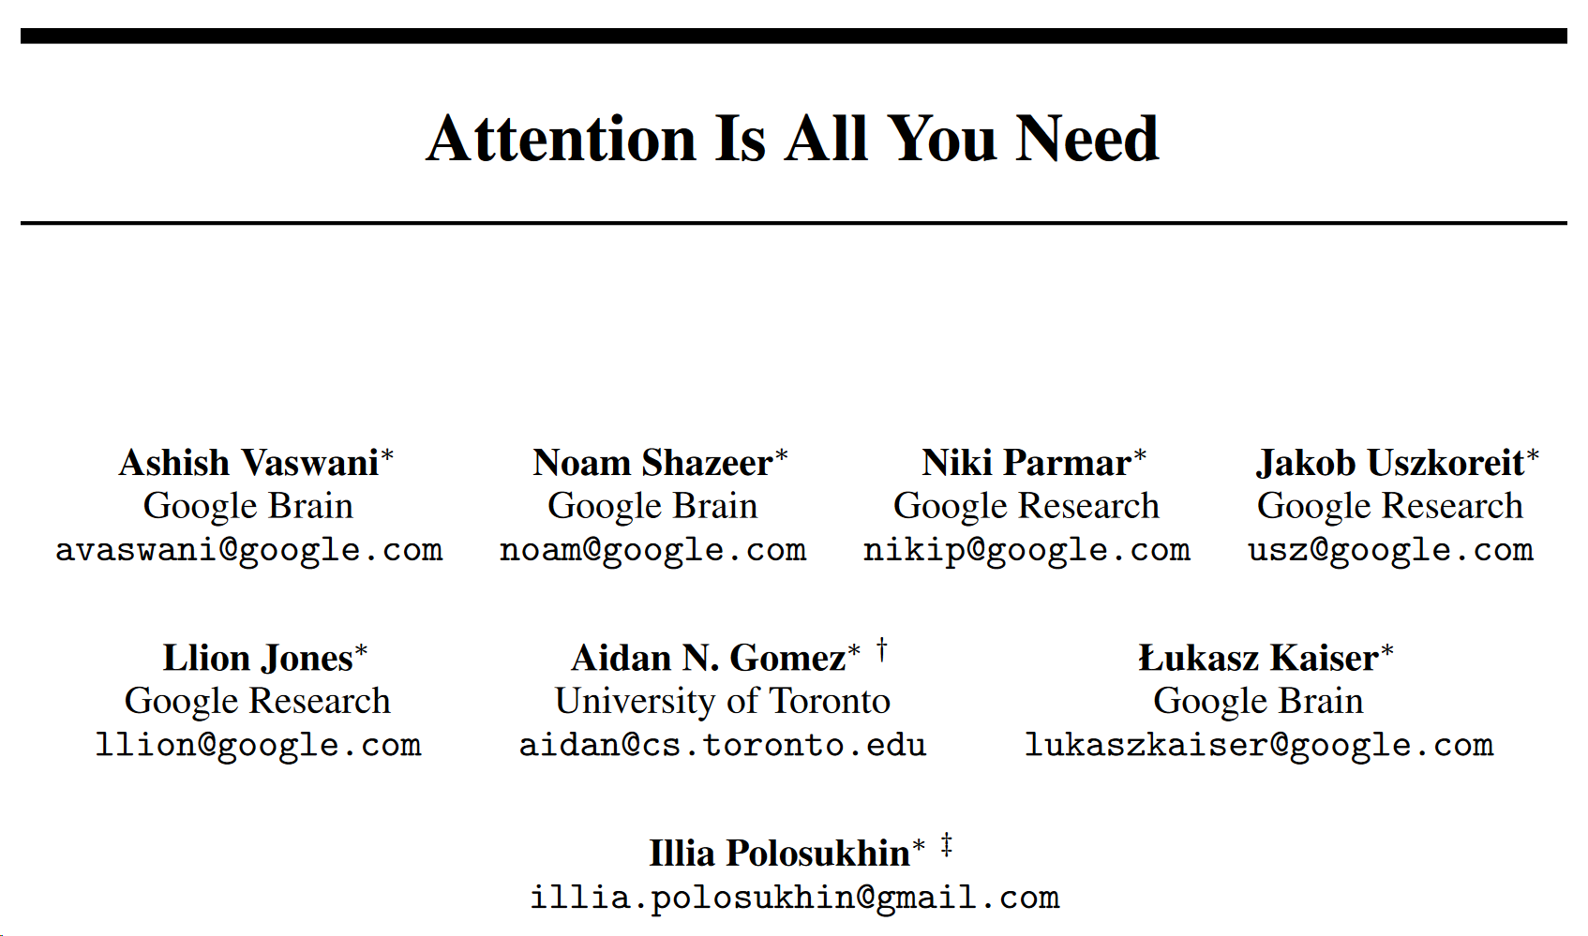
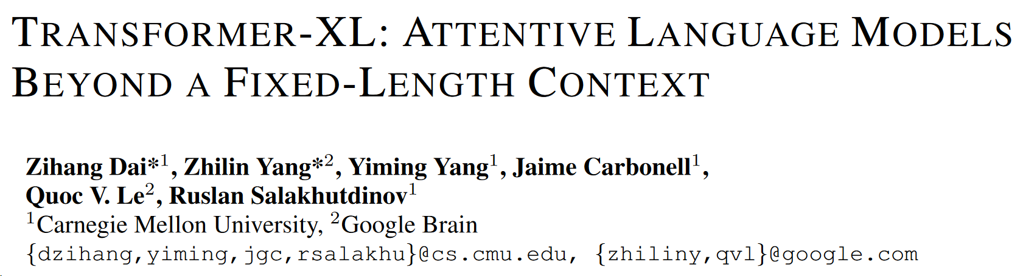
Attention mechanisms
Use all previous hidden states to predict decoded output at timestep t.
2014 -
2017 -
2018 -
MORE attention and MORE parameters == BETTER performance!!!
If you’re interested check out the papers!
Notes:
Luckily, neural networks can learn arbitrary, non-linear functions! This is where autoencoders come in.
Autoencoders are a special neural network architecture, and fall under the realm of unsupervised learning. When do we want to use autoencoders?
Want to learn representations (features) of the data, but not sure for what task (falls under the realm of representation learning)
The features learned by autoencoders can provide extra data for supervised tasks
When we learn features in a smaller dimension space, we could even cluster our data more efficiently, or even visualize our data if in R^3 or less.
So, what’s the main idea behind autoencoders? Learn the identity function with a bottleneck!
The idea is to design a neural network architecture such that we impose a bottleneck in the network. This bottleneck (show on slide), forces a compressed knowledge representation of the original input. If the input features were each independent of one another, this compression and subsequent reconstruction of the “original” input would be a very difficult task. However, if some sort of structure exists in the data (ie. correlations between input features), this structure can be learned and consequently leveraged when forcing the input through the network's bottleneck.

Slide 35
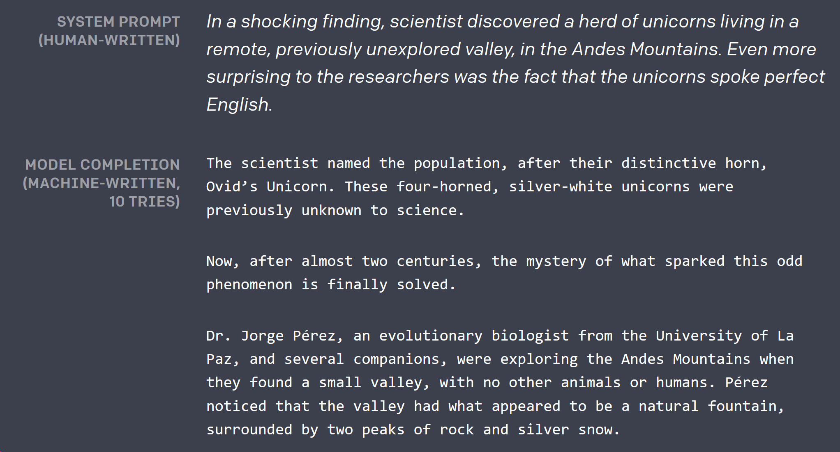
Where do current NLP models fail?
It seems like state of the art language models do very well in certain tasks!
One big area where modern NLP (and deep learning in general) fails - common sense reasoning.
Winograd Schema Challenge
Taken from https://blog.openai.com/better-language-models/
Notes:
As visualized above, we can take an unlabeled dataset and frame it as a supervised learning problem tasked with outputting x^, a reconstruction of the original input x. This network can be trained by minimizing the reconstruction error, L(x,x^), which measures the differences between our original input and the consequent reconstruction. The bottleneck is a key attribute of our network design; without the presence of an information bottleneck, our network could easily learn to simply memorize the input values by passing these values along through the network (point to slides).
Note: In fact, if we were to construct a linear network (ie. without the use of nonlinear activation functions at each layer) we would observe a similar dimensionality reduction as observed in PCA. That is, for PCA, choosing the m’ eigenvectors of the covariance matrix of X would be similar to training an autoencoder with a single hidden layer and m’ hidden nodes. Keep in mind, that is assuming that the activation functions in the hidden units are linear.

Slide 36
Thanks!
Any questions?
Reminders:
Homework 4 Due next week!
Deliverable 2 should be submitted - Deliverable 3 due in 2 weeks!
Fill in feedback form (https://goo.gl/forms/GDhcRQUr5HmYfpNg2). We have quality feedback so far, but not a lot!

